Slide 1

VE496 Advanced Technical Communication
Week 8, Day 1:
Reporting Graphical and Visual Data
Nathaniel T. Murray 莫子禅
Summer 2020

Slide 2
Use of Graphics and Visuals in the Report
Appearance
Colors
Clarity
Label or caption
Numbering
Precision and specificity
Reference within the text
Appropriate signaling words

Slide 3
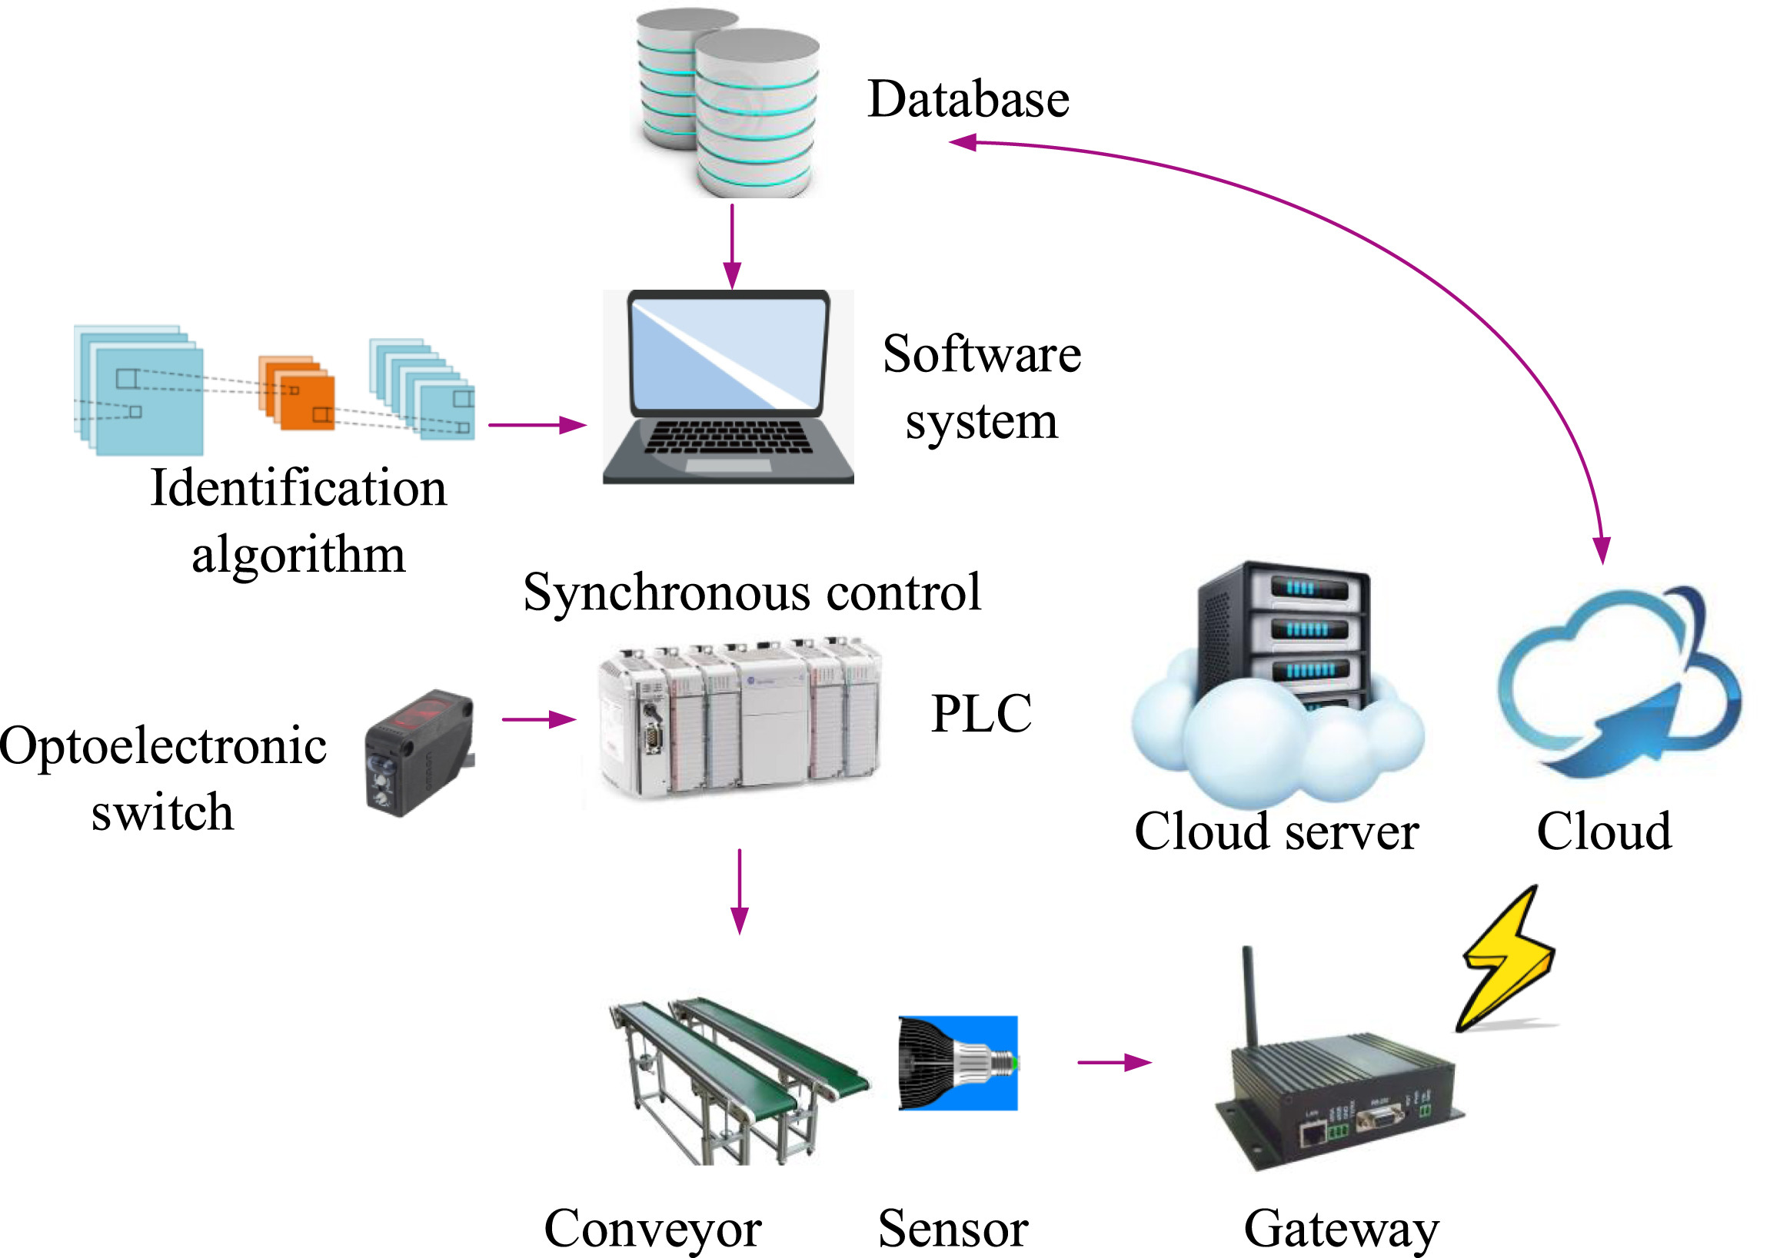
Referring to a Schematic
The structure diagram of the system is shown in Fig. 1. The classification process of the wheel intelligent classification system is:
(1) The hub is transmitted through the production line. When the hub reaches the system area, the photoelectric sensor automatically detects the hub. The PLC control module receives the hub arrival signal and transmits the shooting instruction signal to the camera.
(2) The camera acquires a clear and complete image of the wheel by cooperating with the lens and light source.
(3) The camera sends the collected images to the software system through the Internet of Things system.
Fig. 1. System structure diagram.
Source: Mo & Sun (2020)

Slide 4
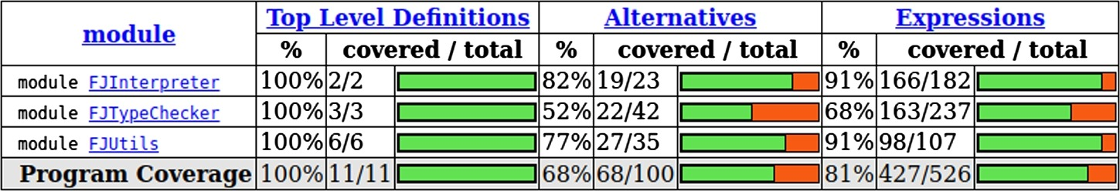
Referring to a Table
Fig. 7. Test coverage results. (For interpretation of the colors in the figure(s), the reader is referred to the web version of this article.)
First, we present in Fig. 7 the summary statistics, which shows results of code coverage for each module of our hand-written interpreter. Each line brings us information about one module of our implementation: evaluator, type-checker, auxiliary functions, and total, respectively. The first column shows that 100% of ‘top level definitions’ were reached when running the test suite. It means that all functions and inductive definitions were used during the tests. The second column shows that between 52% and 82% of ‘alternatives’ were reached, which represents the execution of conditionals, guards, or case branches. And the third column shows that between 68% and 91% of ‘expressions’ were performed, demonstrating that variables, equations, and other terms were reached during the execution of the test cases.
Source: Feitosa et al. (2020)

Slide 5
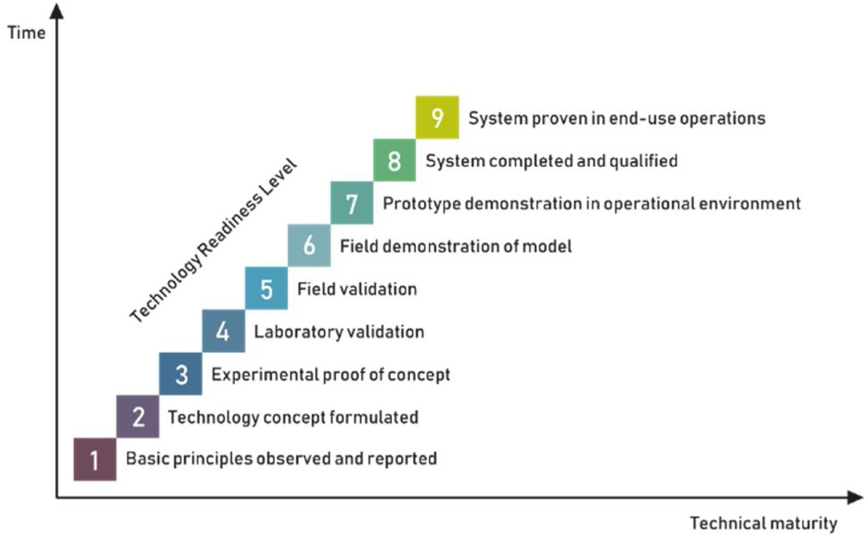
Referring to a Chart
Data extraction was performed from full-text analysis. Extracted data included the area of application within dentistry (Table 1, Table 2) and for robot technology the estimated readiness level according to the information provided in the original research papers (Fig. 2). The presented technologies were assigned to a technological readiness level according to the information given in the publications. Systems were assigned to level 1 when a basic description of a system principle is observed and reported. Level 2 is achieved when a full concept for a system was formulated. Levels 3 and 4 include in vitro validation, whereas levels 5 and 6 are field validations. Technological readiness level 7 is achieved when a prototype is demonstrated in the operating environment. Level 8 is reserved to qualified complete systems and level 9 is reached at the time when a system has been proven in end-use operations. Furthermore, the application areas were put together in order to point out the advances within the different fields.
Fig. 2. The technological advance of a system may be described using the technological readiness level (TRL1-9) introduced by Mankins in 1995 [94].
Source: Grischke et al. (2020)

Slide 6
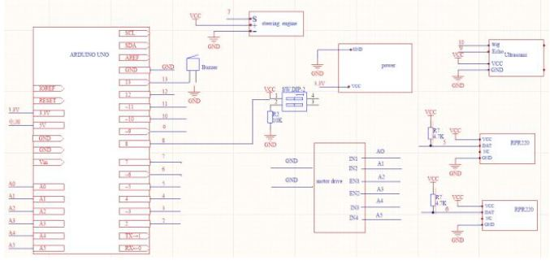
Referring to a Diagram
The control system of the intelligent tracking obstacle avoidance wheel type robot is based on the control system of the Arduino development board. It needs to run some embedded facilities and equipment capable of signal recognition, and infrared signal transmitting and receiving equipment to realize signal recognition and transmission. In the design of the system, five parts of motor drive module, ultrasonic obstacle avoidance module, photoelectric sensor tracking module, automatic speed control module and power module were designed and completed. Each module has been carefully designed and tested several times before being fully integrated into the overall design framework of the intelligent wheeled robot. Figure 2 is a hardware wiring diagram of the design.
Figure 2. System wiring diagram
Source: Li et al. (2020)

Slide 7
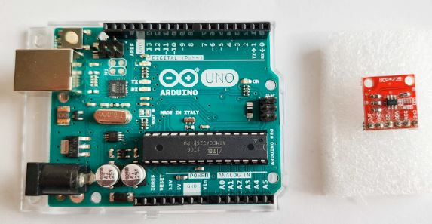
Referring to a Photograph
Arduino Uno R3 uses the 8-bit microcontroller ATmega328P that is placed on the development board equipped with input/output (I/O) pins, connectors (USB, power) and other necessary components for operation of microcontroller (Fig.1). For our purposes it is important that Arduino Uno has analog inputs (6) for signal measurements and digital I/O pins (14) from which 6 pins support PWM signals. Arduino Uno does not have any analog outputs therefore to produce wave signals for frequency characteristics we will have to use an additional board that will serve as a digital-analog converter (12-bitMCP4725). The board of Arduino can be powered also by the USB cable.
Fig. 1. Arduino Uno board and digital-analog converter CP4725
Source: Bisták (2019)

Slide 8
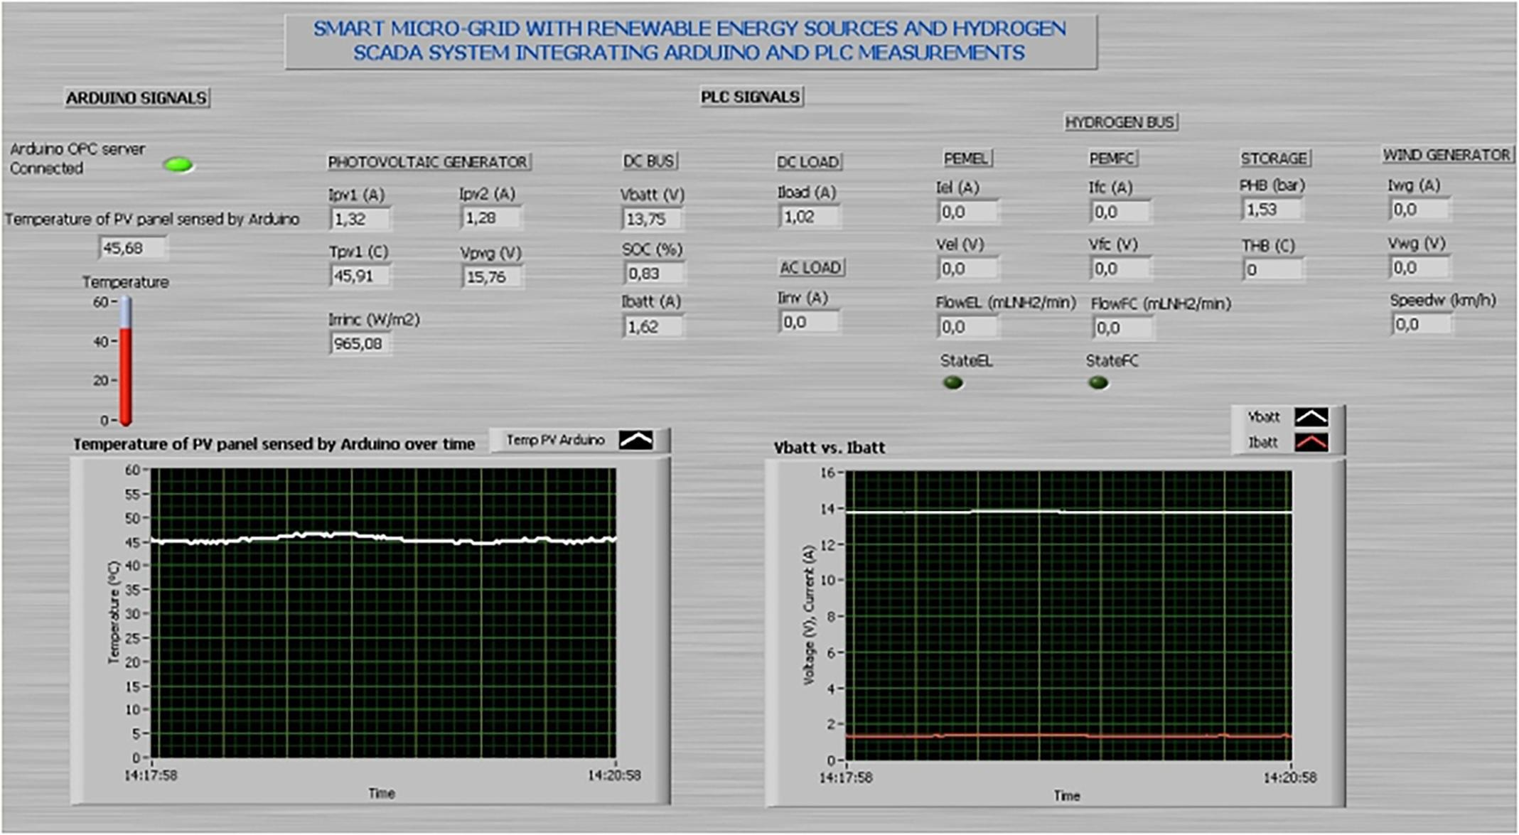
Referring to a Screenshot
In order to reflect the effective operation of the approach, Fig. 11 shows the screen of the SCADA (Supervisory Control and Data Acquisition) system under real working conditions. As can be seen, the information provided by both the Arduino board and the PLC (Programmable Logic Controller) is displayed in the same screen … As can be observed in the figure, a graphic chart is dedicated to the sensed temperature of the PV panel, showing the evolution of this magnitude over time. Also, an output field called Indicator in LabVIEW shows its numeric value … The currents provided by the two PV panels are portrayed, which are enough to cover the demand of the battery and the load. Another graphic has been included to depict the evolution of the battery current and voltage since these are the most illustrative variables of the SMG operation.
Fig. 11. Front panel of the LabVIEW-based SCADA working
Source: González & Calderón (2019)

Slide 9
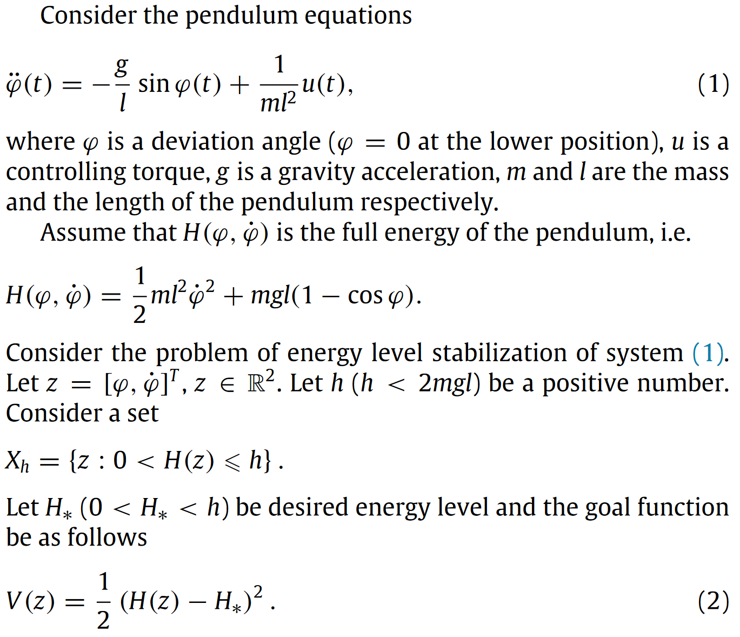
Referring to Equations
Separate the equations into the text (don’t just dump many equations onto the page and think your work is done)
Refer to each equation, both before and after
Treat the equations like a part of the sentence
Use programming-like language (e.g. “If-then”, “Let”) as you would when writing actual computer code
Source: Ruslan et al. (2016)

